Slide 1
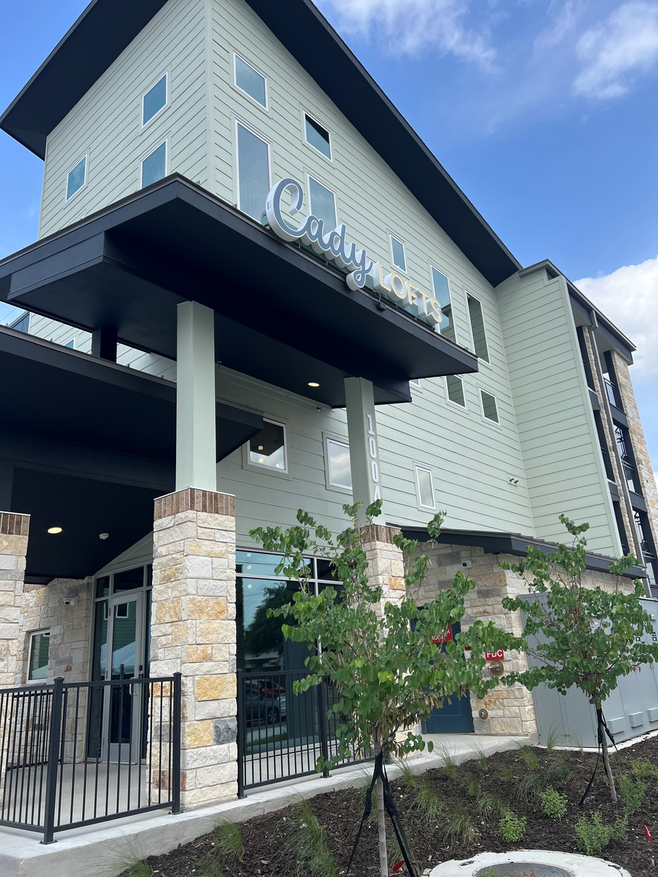

Our Vision:
Everyone has access to stable housing and the support they need to thrive.

Slide 2
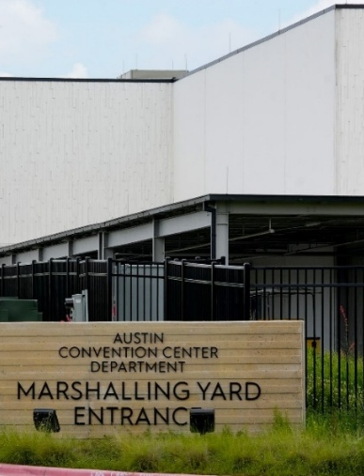
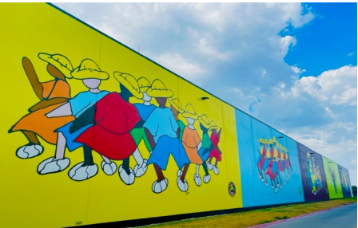
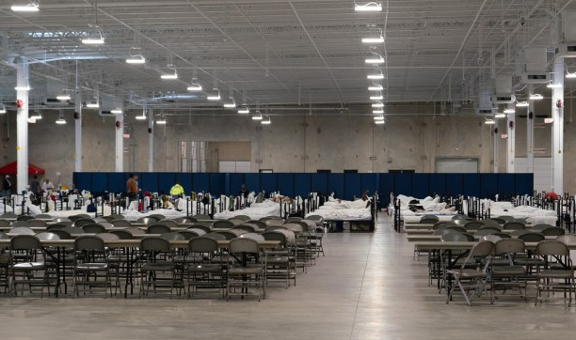
HSO Strategic Pillars
System Leadership
We are a trusted system leader, working collaboratively to ensure an efficient, accessible, and effective homeless response.
Impactful Community Investments
We make investments that resolve individual experiences of homelessness and result in meaningful system change.
Crisis Response System Management
We ensure that people experiencing homelessness have easy access to basic needs, outreach, crisis shelter, and other services to support survival and pathways to stable housing.
Communications
Through public dialogue and intentional communication with stakeholders, we strengthen community trust, align efforts and drive systemwide impact.
Investing in our People
We pursue a culture of continuous learning, creating a collaborative, supportive, and engaging workplace that centers growth, development, and well-being. Our staff are inspired and empowered to drive meaningful change.

Slide 3
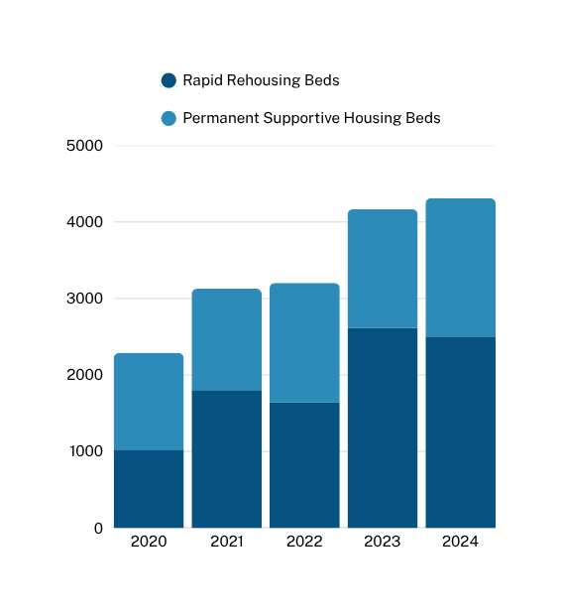
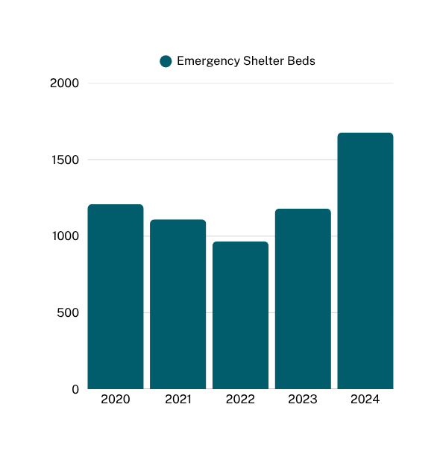
We’re building the capacity to serve more households and reduce unsheltered homelessness.

Slide 4

We’re getting upstream with prevention and early intervention, serving more Austinites more quickly.
Example Housing Situations
People facing eviction
People with low incomes who are severely rent burdened
People experiencing partner or family violence
People who are doubled up or living in other unstable housing situations
Help Households Exit
Homelessness & Then
Promote Stability
Stabilize
Divert
Quickly Resolve Crisis
When Not Prevented
HSO Investments in Early Intervention
Digital navigation and resource hotline
Prevention programs for households/youth
Diversion resources for quick resolution of new homelessness
Leverage brick-and-mortar facilities such as shelters and navigation centers to provide rapid exit funds.
Prevent
Problem Solve Before
Crisis Happens
$34,000-$40,000 Average cost of RRH or PSH services and subsidy per client per year.
$2,040 Average one-time cost per early intervention per client.

Slide 5
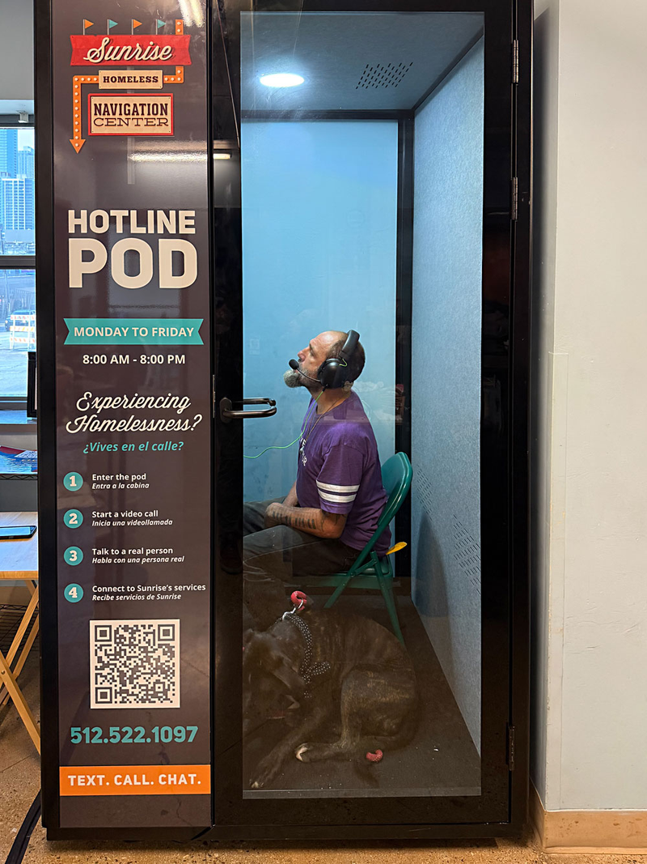
Spotlight:
Digital Innovations
PEH Text Alert System
Launched in 2023 to enhance emergency notifications.
Reaches more than 5,000 subscribers.
Navigation Hotline
Staffed 60 hours per week.
Immediate screening for early intervention eligibility.
Live referrals to appropriate resources.
1/3 of callers are families with children.
Service Pods
Deployed at high traffic social and health service locations, like navigation centers and emergency rooms.
Video conferencing and tele-health capabilities.
Clients can complete or update a housing assessment.
Reduces need to visit brick-and-mortar locations.
Online Resource Finder
Launched austintexas.gov/opennow in 2025.
Provides interactive, up-to-date information on the availability and locations of resources.

Slide 6
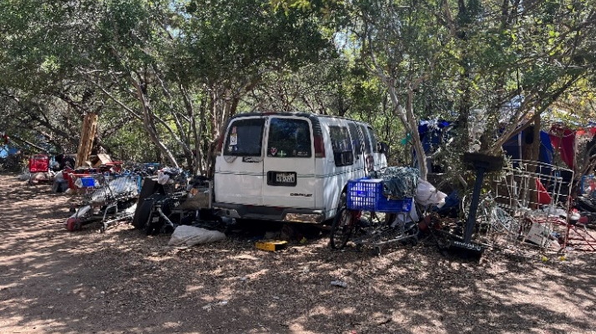
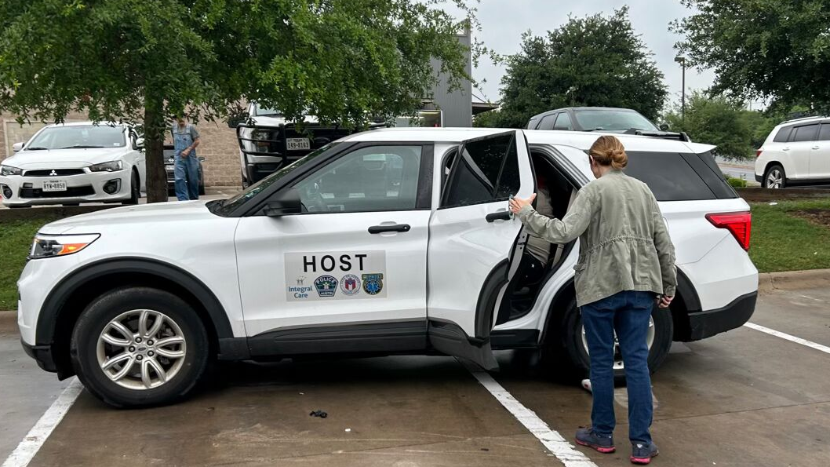
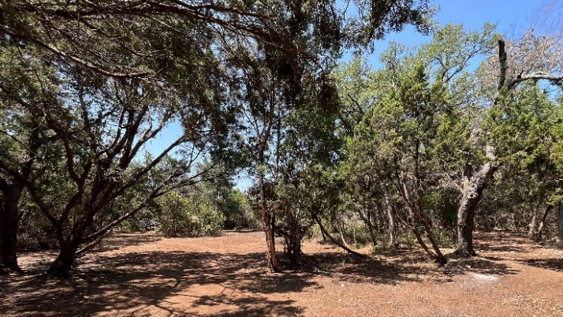
We’re learning from our successes and continuing efforts to fill key system gaps.
Continue upstream systems investments
Lauch homeless prevention collaboration with ECHO
Open new housing navigation center to prevent homeless and support rapid exits for newly homeless
Adding shelter and housing capacity
Add 150 new beds in FY26, including 50 family shelter beds
Administer services funding for new PSH units
Continue partnership with Housing Connector to engage landlords
Address mental health gaps
Expand HOST partnership with Integral Care, DACC, APD, and EMS
Contribute to the success of the ‘No Wrong Door’ initiative
Support addition of skilled nursing facility, therapeutic residential treatment, and behavioral health respite beds
Improve outcomes for key subpopulations, including:
Chronic homeless and mentally unstable
Foster youth, unaccompanied minors, and transitional aged youth
Households with children under age 18

Slide 7
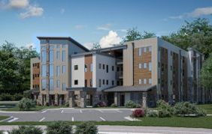
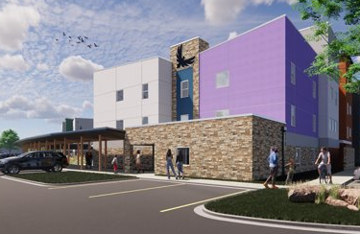
New funding helps HSO and partners grow a more effective and holistic homeless response system.
Fiscal Year 2026 Base Budget Additions: $12.6 million
12 new HSO positions for street outreach and encampment mgmt.
$8 million: ongoing operations for the Marshalling Yard.
$3.5 million: ongoing operations for Eighth St. Women’s Shelter.
Tax Rate Election: Ongoing Funding: $24.86 million
$12 million: funding for 300-350 new Rapid Rehousing units
$5.1 million: funding for 150 new emergency shelter beds
$3 million: funding for 100 positive exits from BRIDGE shelters
$2.26 million: funding for 113 new PSH units
$2 million: funding to improve street outreach partnerships
$0.5 million: funding for homeless navigation centers
Tax Rate Election: One-Time Funding: $3.9 million
$2 million: funding to support community-based shelters
$1.1 million: funding to support landlord engagement
$0.5 million: funding to support homeless diversion services
$0.3 million: funding for showers at Charlie Center
TOTAL INVESTMENT: $41.36
Not including Local Housing Vouchers ($3.7M), increase for Emergency Rental Assistance ($400K), etc.
The Roz
Libertad

Slide 8
Thank You, Partners!

