Slide 1


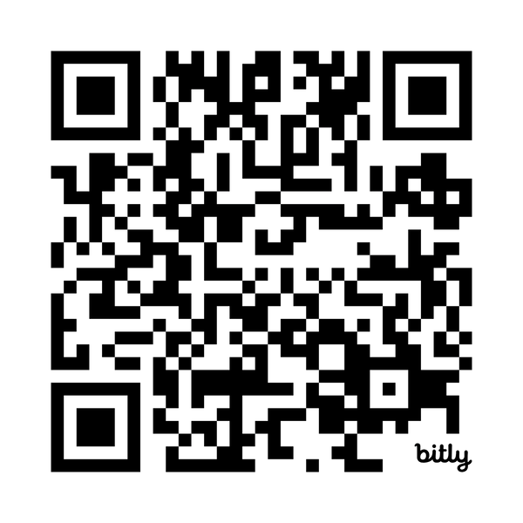

State
Read the Report:
2025
of the
System
People, programs, and progress in Austin/Travis County’s
Homelessness Response System (HRS)

Slide 2

Who We Are
About ECHO
The Ending Community Homelessness Coalition (ECHO) is the backbone of our community’s Homelessness Response System. As the lead agency for the Austin/Travis County Continuum of Care, we lead and align a coalition responsible for planning and implementing community-wide strategies to end homelessness. We work alongside people with firsthand experience of homelessness and nonprofit, government, and philanthropic partners to build a future in which everyone in our community has housing of their choice that provides a foundation for optimal health, success, and stability. Learn more: austinecho.org
Kate Moore
(she/her)
Vice President of HRS Strategy
Joseph Erik Montaño
(he/him)
Director of Research & Evaluation
Notes:
Hello, I am Kate Moore, the VP of the HRS strategy, and I am here with Joseph Montano, our Research and Evaluation Director to give you a brief overview of our 2024 State of the System report.
As the lead agency for the Austin/Travis County continuum of care we are pleased to be able to present an annual analysis of how our Homelessness Response System is functioning. This provides accountability for all of us as a community to understand how investments are working, what could be improved, and what investments or changes are still needed. We want to emphasize that these numbers reflect real people, our neighbors, who should never have to suffer the trauma of living unhoused. To reiterate what Matt said… This report also reflects the hard work of hundreds of people who lead and staff our homelessness response system. Those provider agencies take on the challenge every day to support our neighbors, through a meal, a bed, a home, and through a human connection. Many of those providers are here today and we want to thank them for what they do. They are our partners and allies in this housing justice work. We also want to thank our partnerships with the many funders of this system, large and small. Including the City of Austin, HSO, the Housing Department, Travis County, Central Health, the Housing Authority of the City of Austin and countless other foundations and individuals who fund this important work.

Slide 3
About the Report
The 2025 State of the System report:
  encompasses data from calendar year 2024, as well as 2019-2023
  pulls data from the Homeless Management Information System (HMIS)
  identifies progress, needs, gaps, and disparities in Austin/ Travis County’s Homelessness Response System (HRS)
Notes:
This data reflects information from the calendar year 2024, but also looks back at trends back to 2019 when we can. This analysis is only possible because of the data entry by hundreds of provider staff into our collaborative database, the Homelessness Management Information System, or HMIS.
Our goal at ECHO for this report is to inform funders, providers and the community of the progress, but also the changes and gaps needed to improve our system.

Slide 4
Key Takeaways
After years of under-investment in services, our System is growing to match the needs of our community.
Fewer people are coming to providers for help for the first time.
Notes:
We have some good news to share with this report.
Investments made by our community have started to show a real impact and improvements for people experiencing homelessness.
One of the key indicators for us, is that fewer people are becoming homeless - slowing that flow into our system.

Slide 5
Key Takeaways
Our System is becoming more efficient.
Disparities still exist amongst several groups.
Notes:
With the increased scale, the homelessness response system is becoming more efficient which lessens the suffering of people experiencing homelessness by housing them faster and providing more crisis response options, such as shelter beds and diversion funding.
While a lot of progress has been made, there are still people who are over represented in our system based on systemic inequities in our society.
In short, what we are doing is working, but we still have work to do. We need to keep growing our system to meet the needs of everyone.

Slide 6
People 'served' by the Homelessness Response System include people who:
  stayed at a shelter for a night
  were housed the entire year through an HRS program
  got housed in 2024
  were homeless for all of 2024
  were at risk of homelessness but kept their housing
Notes:
There is no singular experience for People Experiencing Homelessness.
And the variety of circumstances people face when experiencing homelessness is vast.
This variety is reflected in the types of services that are documented within our Homeless Management Information System and so the People reflected in this report can include people who [read slide].
we acknowledge the diversity of experiences as well as our inability to speak on behalf of all People Experiencing Homelessness.
So the following findings are not meant to define the experience of people experiencing homelessness. Instead, they review the performance of the Homelessness Response System to understand the remaining needs, gaps, and disparities and then translate them into actionable recommendations to improve people’s lives and end homelessness for everyone in our community.

Slide 7
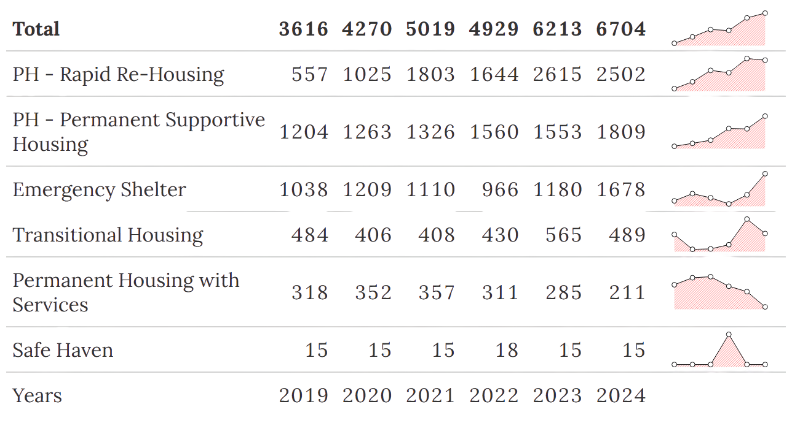
Beds and units continued to grow for our system overall
Notes:
Beds and units continued to grow for our system overall.
Over the past five years, our system has experienced a 108% increase in overall capacity, driven by substantial growth in Permanent Supportive Housing (PSH), Rapid Re-Housing (RRH), and shelter beds. Capacity for RRH and PSH projects has more than doubled during this period.
Capacity has expanded across nearly all project types compared to 2023 while Emergency shelter capacity, in particular, increased by more than 40% in 2024.
We can see our community's investments in Housing and Shelter and this growth in capacity made way for our system to assist more People Experiencing Homelessness.

Slide 8
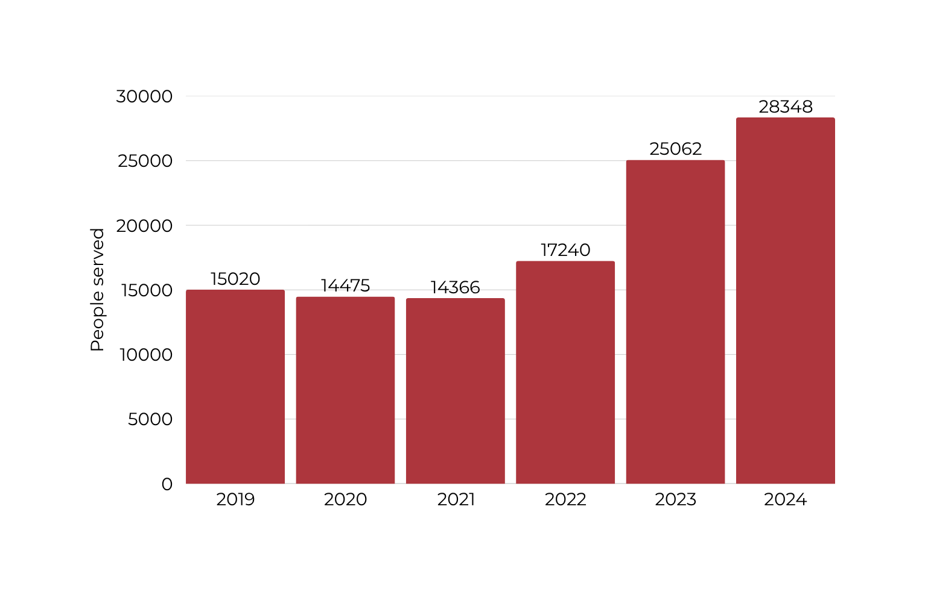
The total number of people served by the Homelessness Response System increased​
2024 saw the smallest increase in people served by the system since 2021, about 13%
Notes:
The Total Number of People Served by the Homelessness Response System increased.
The HRS served 13% more people in 2024 than 2023, which is the smallest increase we have had in the past 4 four years. Continued and expanded investments in shelter, housing, and services created more opportunities to engage People Experiencing Homelessness.
The City of Austin expanded emergency shelter beds at the Marshalling Yard and offered more Cold Weather Shelter. Grassroots organizations are able to participate in HMIS due to the elimination of license fees and help document new types of services that meet the diverse needs of People Experiencing Homelessness. And new Coordinated Entry funding for the community has created more access for people to complete Coordinated Assessments.
While the number of people who experienced homelessness is likely higher than the number of people who formally sought services from the HRS, providers are reaching more people by funding more programs.

Slide 9
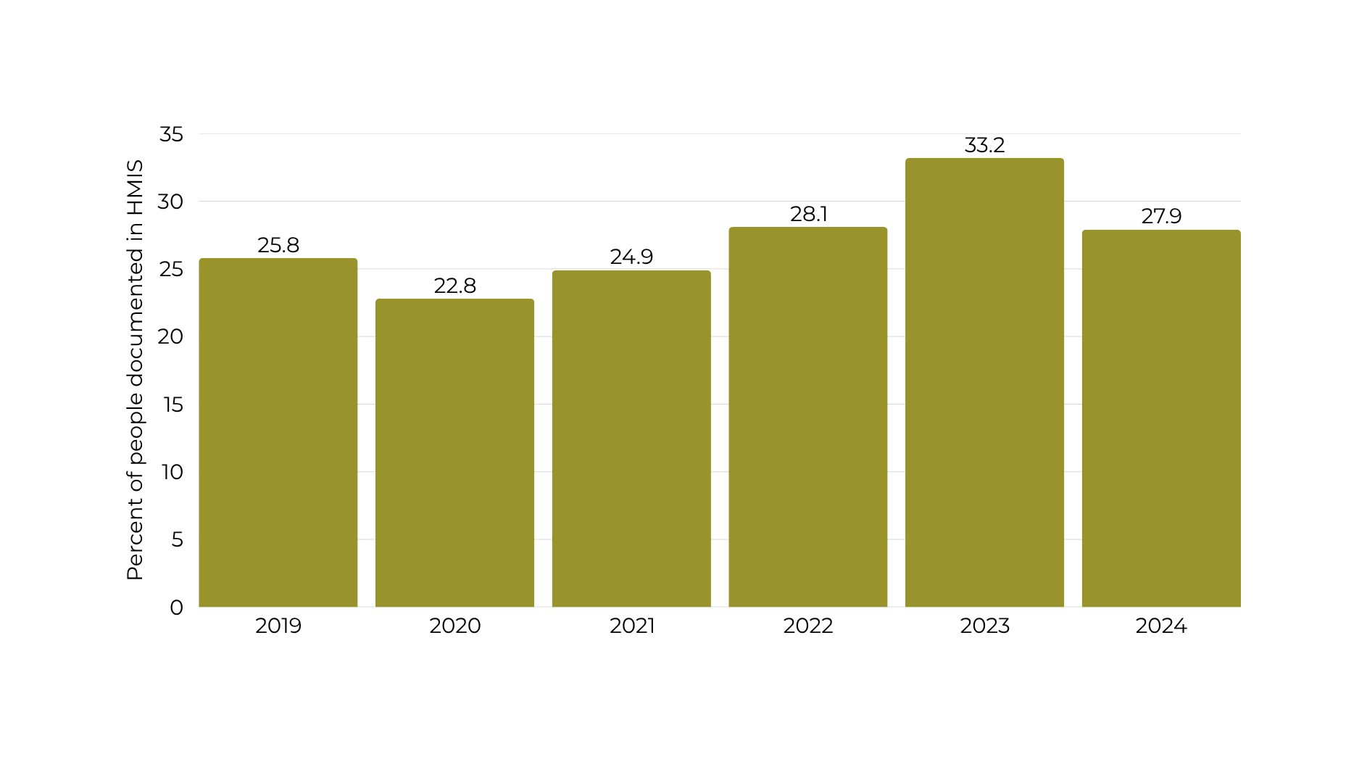
The number of people who became homeless decreased for the first time in five years
Notes:
The rate of people becoming homeless for the first time decreased by 5%, the first decrease in our system since 2020.
In comparison to the growth of all people served in 2024, the decrease in the rate of first-time homelessness indicates our system is doing a better job at re-engaging people who’ve sought services from the HRS in the past.
The growth of supportive and wraparound services funded by the City of Austin, Central Health, and other funding partners is creating opportunities for people who are already homeless to re-engage with the system.
Efforts to develop affordable housing, reduce the number of evictions in our community, and provide minimal housing assistance to people at risk of homelessness have an important impact on our system and further investment for programs that reduce inflow into the HRS should be prioritized to capitalize on the trends seen currently.

Slide 10
Fewer people becoming homeless is promising; our community can build on this by investing more in what works.
The HRS is reaching more people experiencing homelessness. This means our understanding of the population is becoming more refined.

Slide 11
There is still work to do to ensure no portion of our community suffers more than others.​

Slide 12
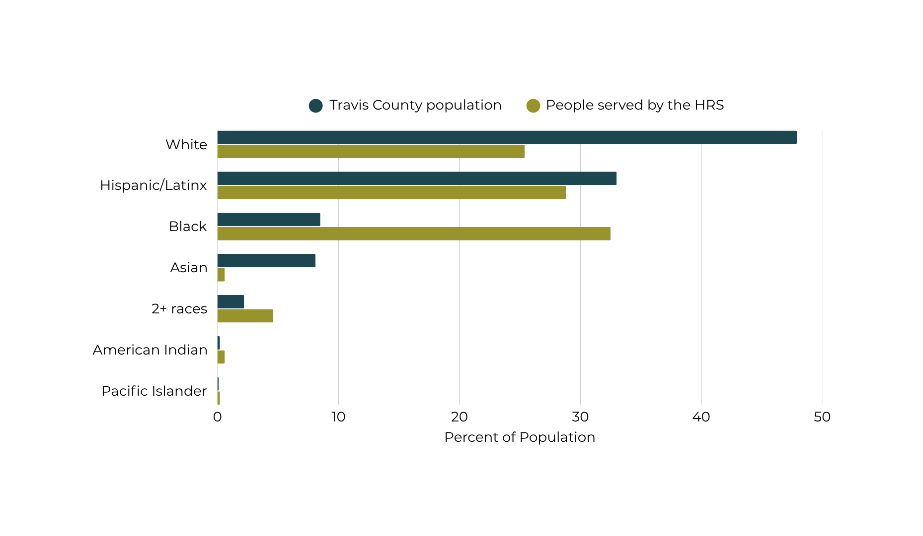
Race demographics still do not match our local census data
Notes:
For example, Black individuals make up only about 9% of the overall Travis County population, they account for one-third of the homeless population. In contrast, white individuals make up almost half of the overall Travis County population yet only account for about one-quarter of the homeless population.

Slide 13
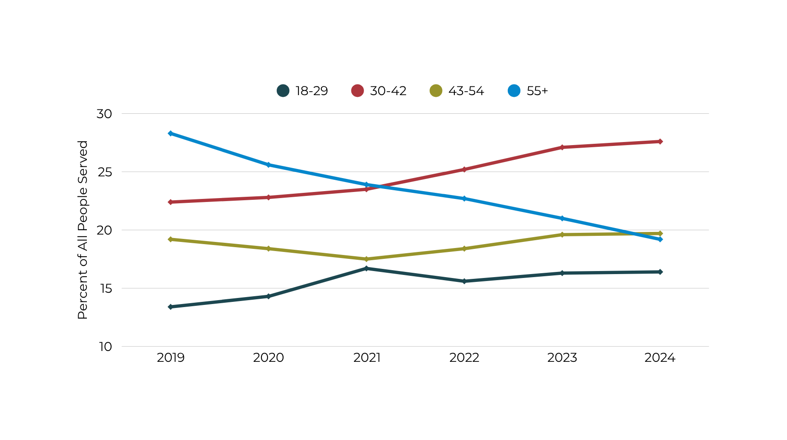
The percentage of older adults decreases while others grow
Notes:
The share of adults over the age of 50 continues to shrink as they become overwhelmed by the growing numbers of younger people in the system.

Slide 14
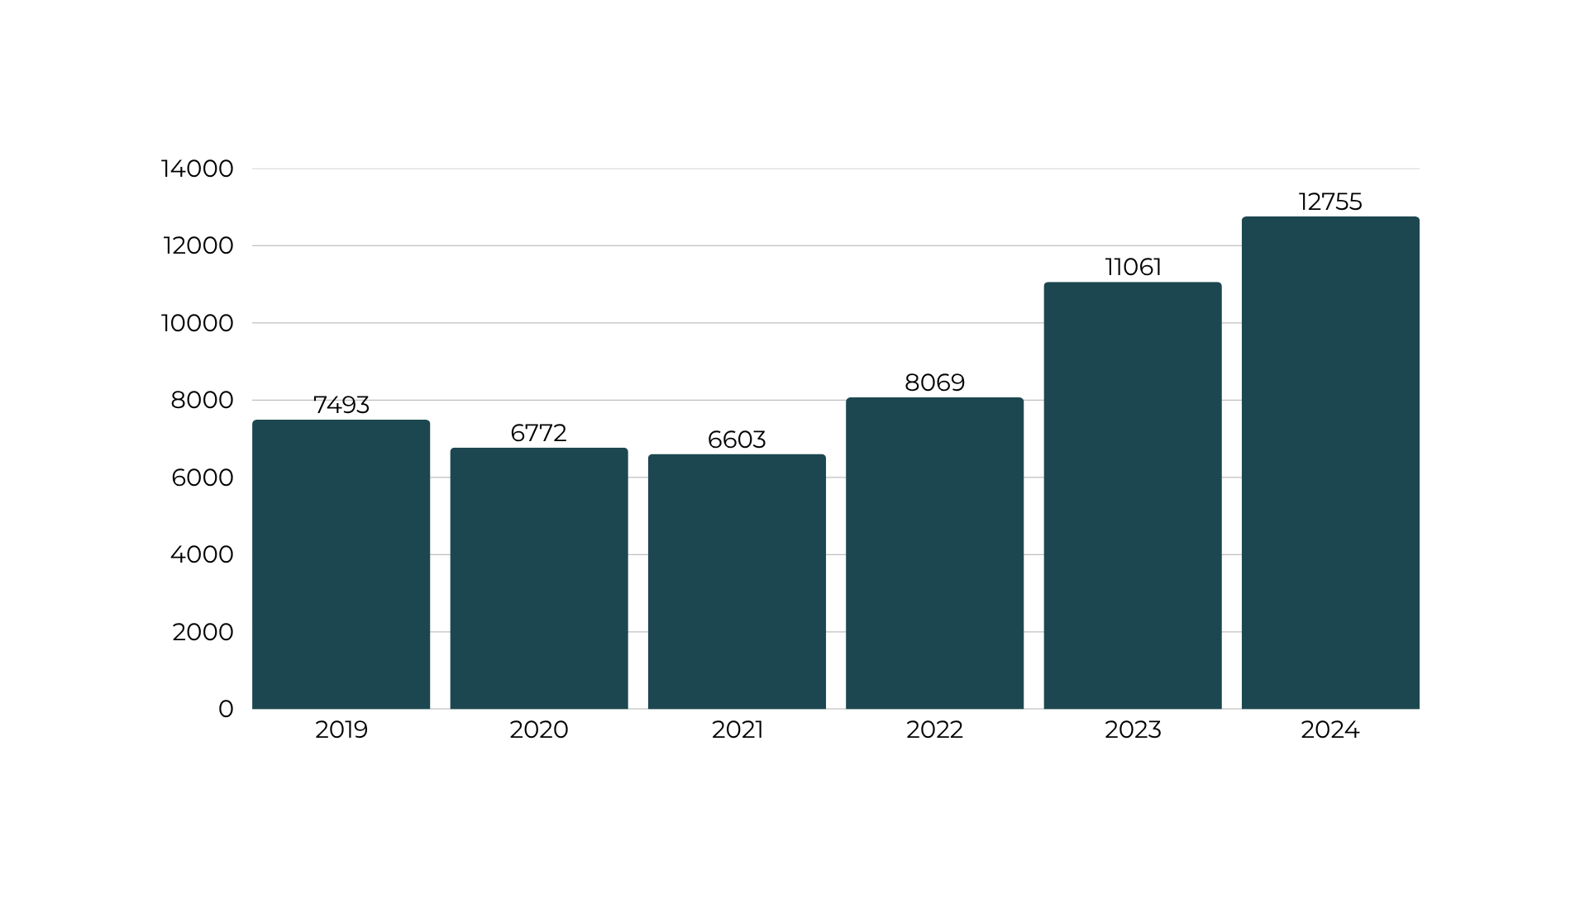

The number of people with disabilities continues to grow
68.8%
68.0%
70.2%
68.7%
59.8%
59.9%
Notes:
nearly 1,700 more people identified as having any sort of disability compared in 2024.
more than three-quarters of heads of households enrolled in PH programs report at least one disability while half of people engaged in programs like Street Outreach, Emergency Shelter, and Coordinated Entry also report at least one disability.
Clients with disabilities have an significant difference in successful outcomes and it is not only housing providers that have to provide effective program administration for high-needs clients.

Slide 15
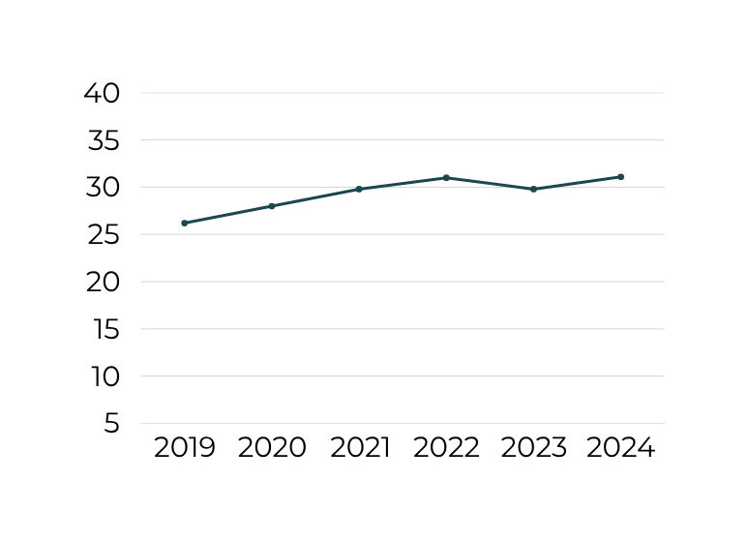
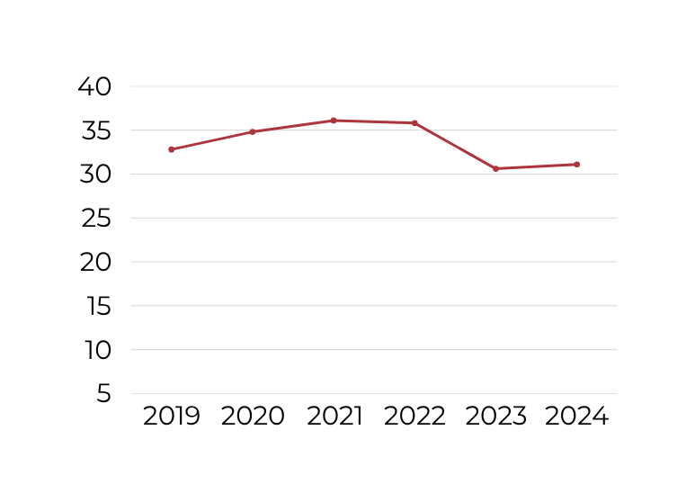
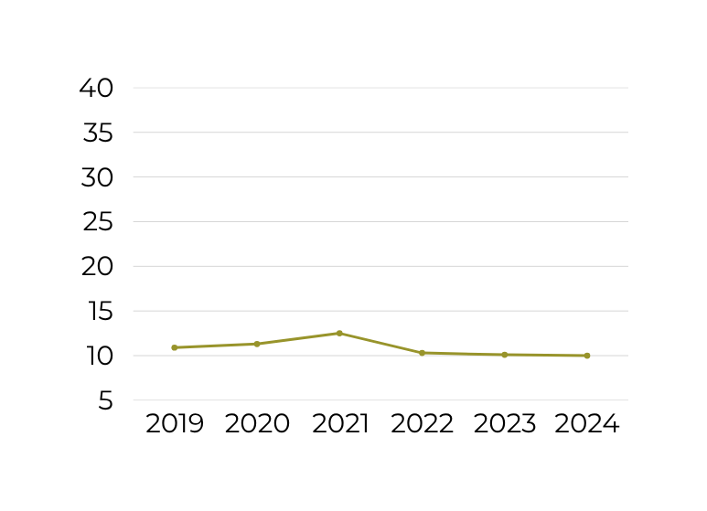
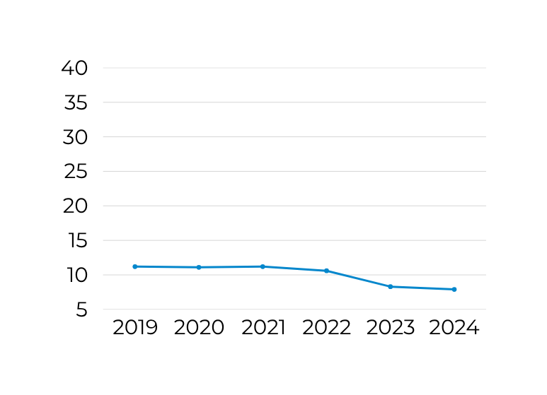
Chronically Homeless
Domestic Violence Survivors
The ratio of people who belong to various sub-populations remain relatively stable
Unaccompanied Youth
Veterans
Notes:
the population of people experiencing chronic homelessness grew by 1,314, Unaccompanied youth grew by 260 people and veterans grew by 113. Survivors account for 31% of the population and grew by 902 people
Funded services and dedicated supports for these groups are still reflective of the need and require continued investment.
As we make progress, it is important to maintain a strong understanding of the unmet needs for people with disabilities, elders, people with high medical needs, and HUD defined target populations like Chronically Homeless and Survivors of Domestic Violence and design our Homeless Response System with them in mind.

Slide 16
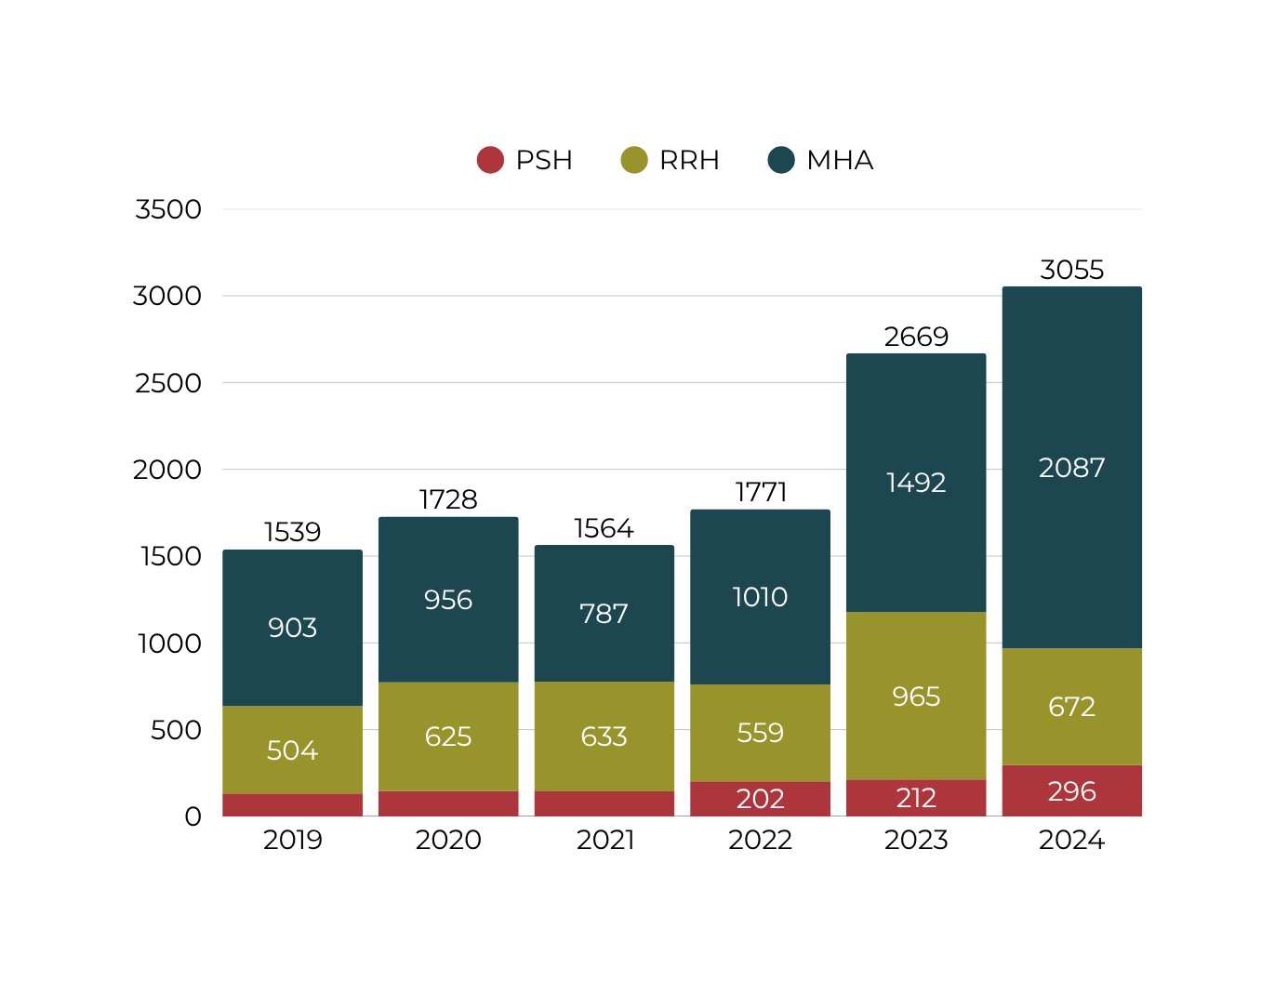
More people moved into housing, led by growth in minimal assistance programs
Notes:
More people found housing in 2024 - 3,055 total. many of these needed only a light-touch service to end their homelessness.
MHA programs are housing significantly more people due to the availability of flexible funding that ends homelessness for people more likely to resolve their homelessness without more extensive support.
Investment in Permanent Supportive Housing led to an increase of over 80 more people moving into housing in 2024.

Slide 17
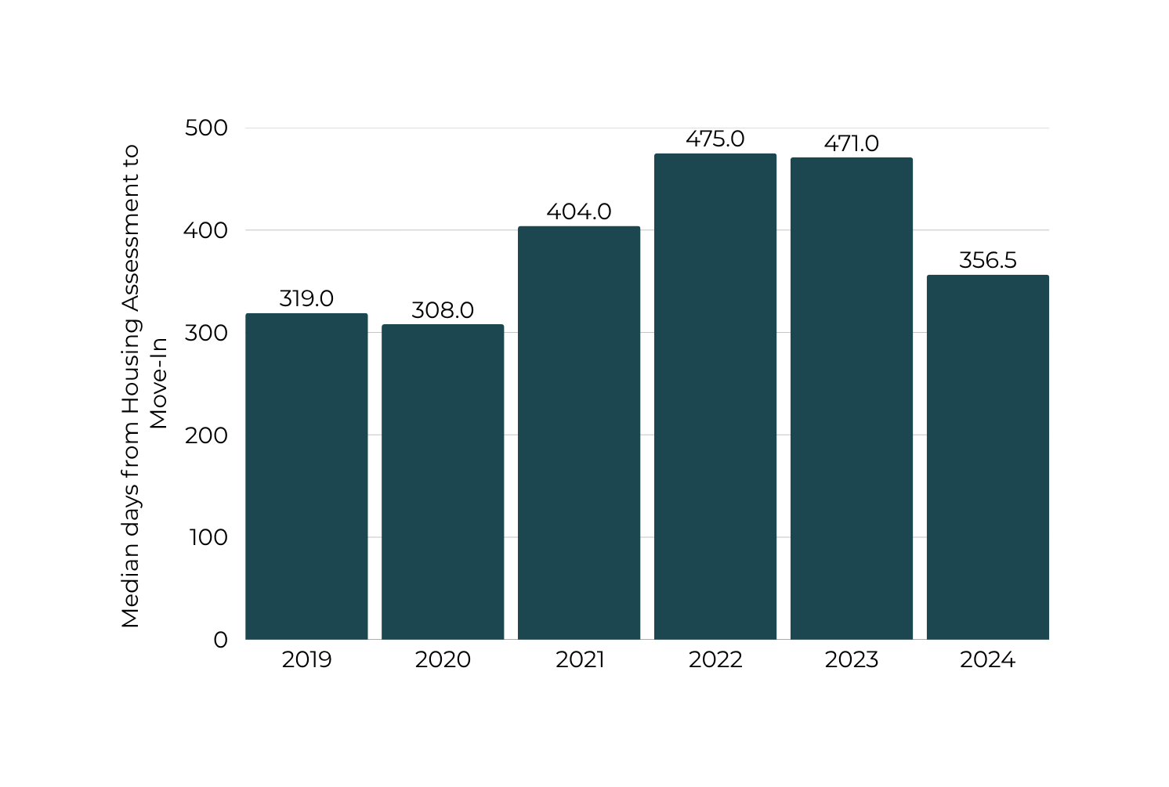
More inventory leads to more move-ins and shorter wait times
People moved into places to live, on average, about four months (114 days) faster after completing a housing assessment
Notes:
The increase in beds in our system meant people moved in faster, reducing time between assessment and move-in by nearly four months.
The community has made a large investment in site-based PSH, with over 1200 units expected to come online through 2027 we can see the effect of more beds on the pace people move through our system.
Still, there is no shortage of stories from people in our community waiting much longer. Many people experience homelessness for far longer and have to complete multiple CAs before being housed through the HRS - if they are housed at all.
these improvements are being felt by a frustratingly small percentage of people served by our system and there is no better time to continue increasing our system's capacity to meet the need.

Slide 18
Recap
The System is growing to match the needs of our community.
More funding = more beds = more people moving inside
Fewer people are coming to providers for help for the first time.
Investing further in prevention and long-term solutions builds on this progress

Slide 19
Recap
Our System is becoming more efficient.
More move-ins, shorter wait times
Disparities still exist amongst several groups.
There is still work to do to ensure no portion of our community suffers more than others

Slide 20




Q&A
Thank you!
Connect with us:
@atxecho
media Contact:
@atx_echo
Chris Davis
Director of Communications & Public Policy
chrisdavis@austinecho.org
/company/atxecho
austinecho.org

